Slide 1
E-Commerce Application
By: Himashree Hazarika

Slide 2
Introduction:
The buying and selling of products online is called e-commerce.E-commerce basically consists of six categories:
1.Business-to-Business
2.Business-to-Consumer
3.Consumer-to-Consumer
4.Consumer-to-Business
5.Business-to-Administration
6.Aministration-to-Business
The project is implemented keeping in mind the Business-to-Consumer model.This model has dominated a vast portion of the market .

Slide 3
Functional Requirements:
I. User should be able to Login/Logout
2.User should be able to Search by items
3.User should be able to View items added to Cart

Slide 4
Project details:
1.Registration and Login Page
2.Home Page with different sections
3.Options to Add Items to Cart
4.Options to Buy Items
5.Different payment methods
6.Order details.

Slide 5



Tools/Technologies Used:

Slide 6
Working of Project:
1.User first register his account with email and password.
2.User after registration ,he is needed to log in.
3.Once user logs in, he goes to Home Page where there are three options:
a.Men’s Section
b.Women’s Section
c.Kid’s Section
4.User clicks on any one of the options and a new page appears.
5.For instance, if user selects Men’s Section ,he goes to the new page and he sees the list of the available items.

Slide 7
6.A user can search through names from the list of items.
7.After that a new page appears consisting of three options:
a.Add Item to Cart
b.Go to Cart
C. Go to Main
In the Add Items to Cart once an item is added to cart ,it asks for payment if we want to do payment ,it asks for payment details and on doing payment it shows order details.
If we don't want to make payment then it again goes to the previous page .
In Go to Cart,we can see the list of items along with the grand total

Slide 8
We can select items from Goto Cart and select an item and click on payment.
Once we are done ,we logout from the home page.

Slide 9
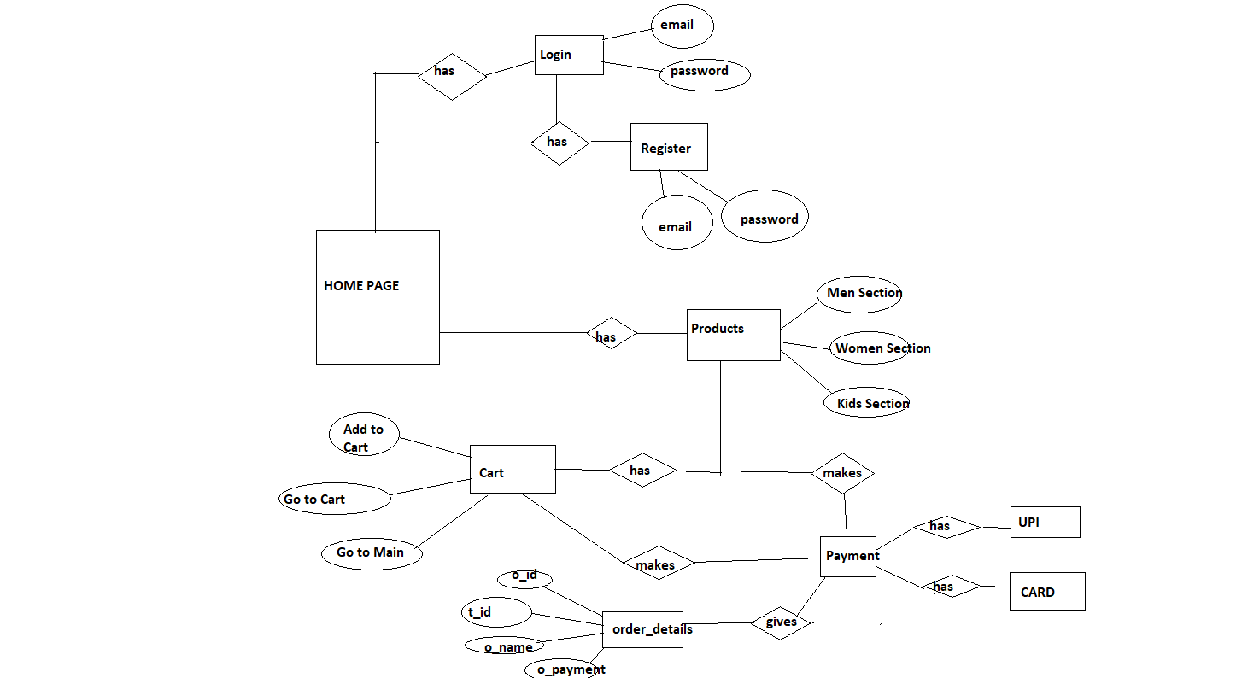
ER DIAGRAM:

Slide 10
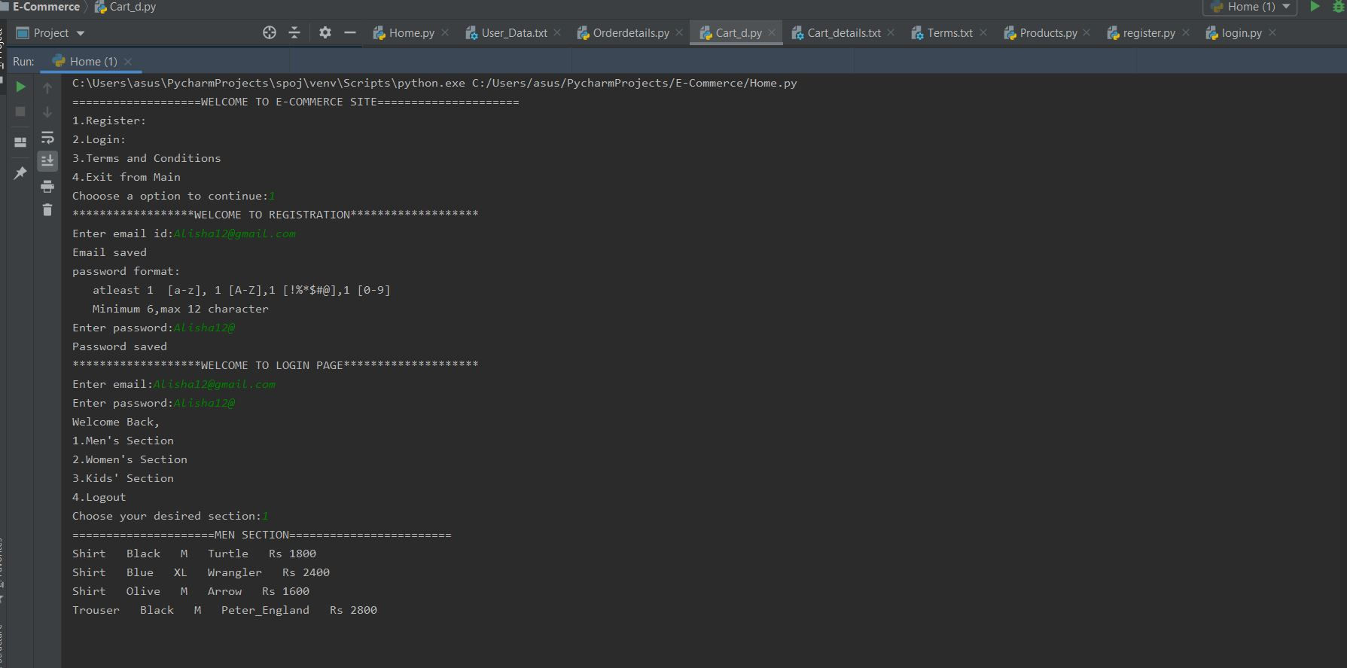
Code Snippets:

Slide 11
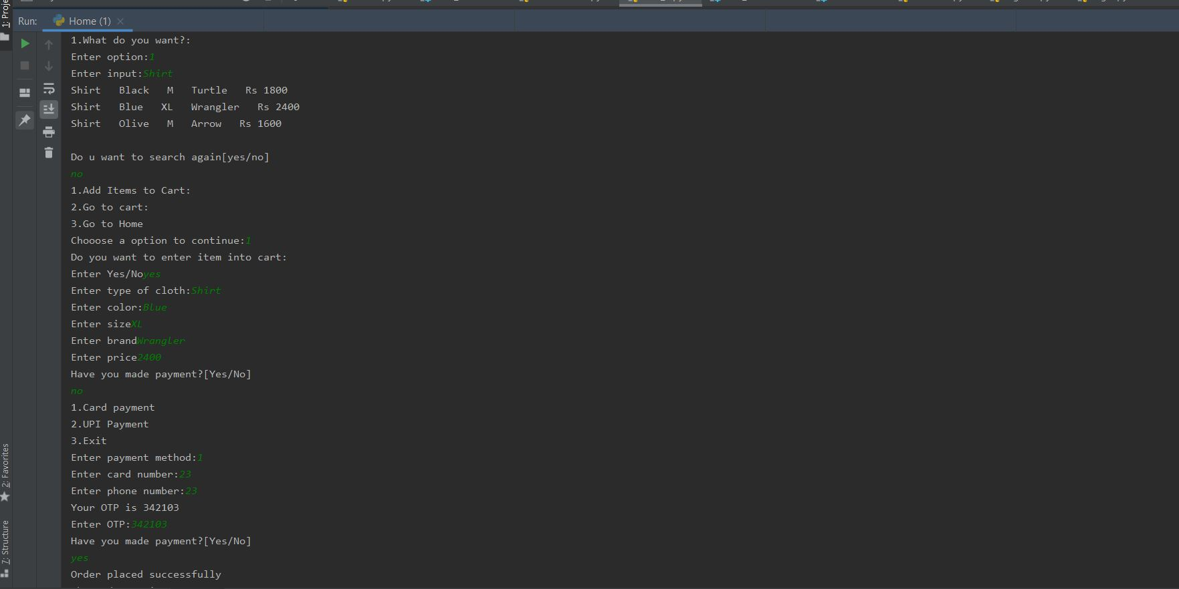

Slide 12
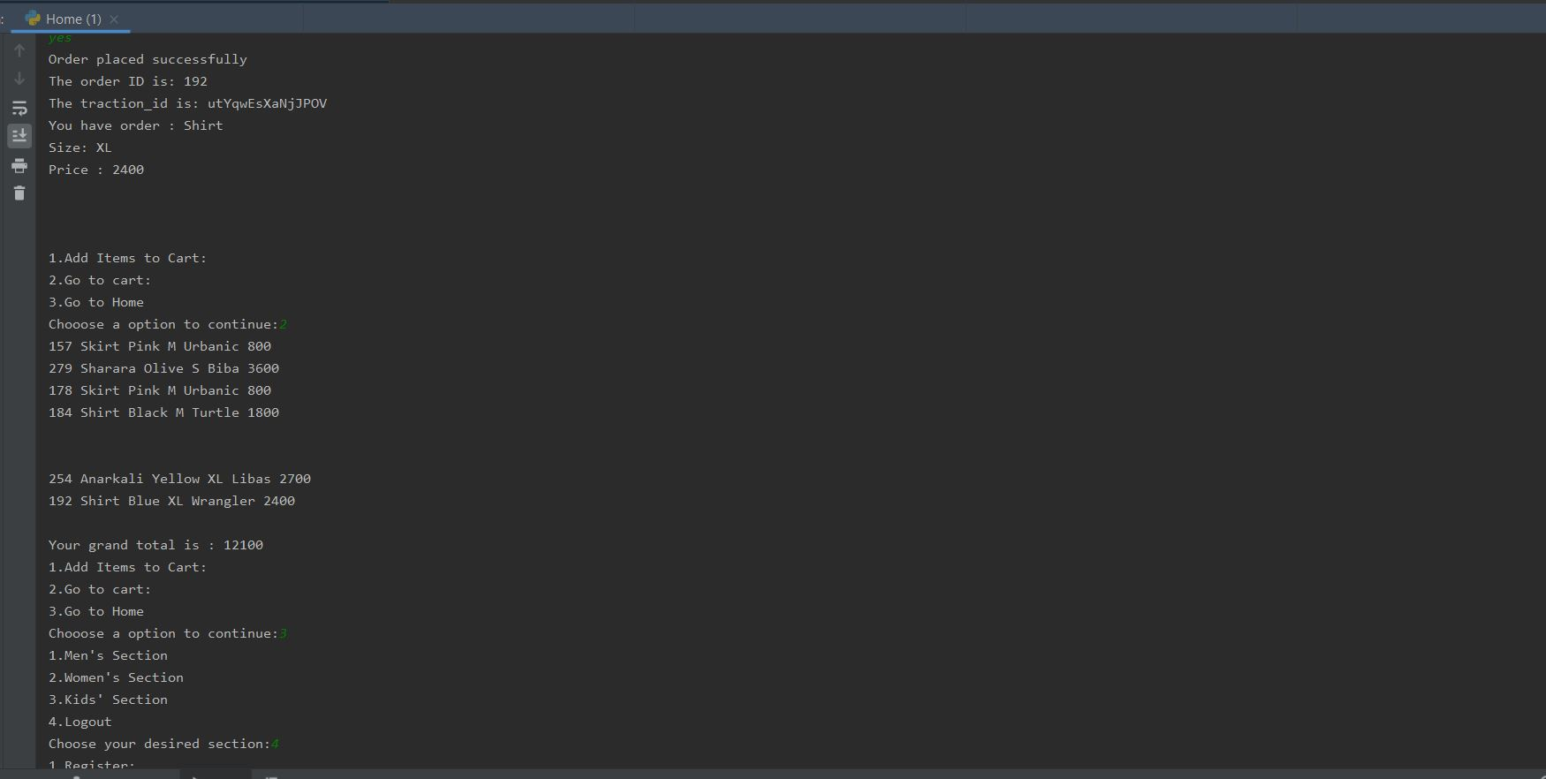

Slide 13
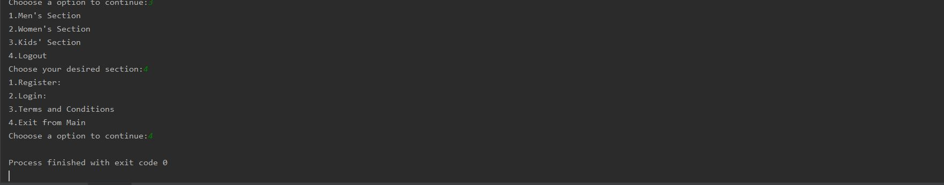

Slide 14
Risk and Issues:
1.Since the data is stored in plain text it can be tempered easily.
2.Once the user logs in,he has to go through different stages of the application which is time consuming.

Slide 15
Conclusion:
E-commerce is revolution.With the availability of internet,more market places and faster transaction it is a blessing for people with busy schedules to just have their shopping by a simple click in their phone.It also reduces the travel cost and time .

